Slide 1
Chapter 9
Relational Database Design by ER- and EER-to-Relational Mapping

Slide 2
Chapter 9 Outline
Relational Database Design Using ER-to-Relational Mapping
Mapping EER Model Constructs to Relations

Slide 3
Relational Database
Design by ER- and EER-to-Relational Mapping
Design a relational database schema
  Based on a conceptual schema design
Seven-step algorithm to convert the basic ER model constructs into relations
Additional steps for EER model

Slide 4
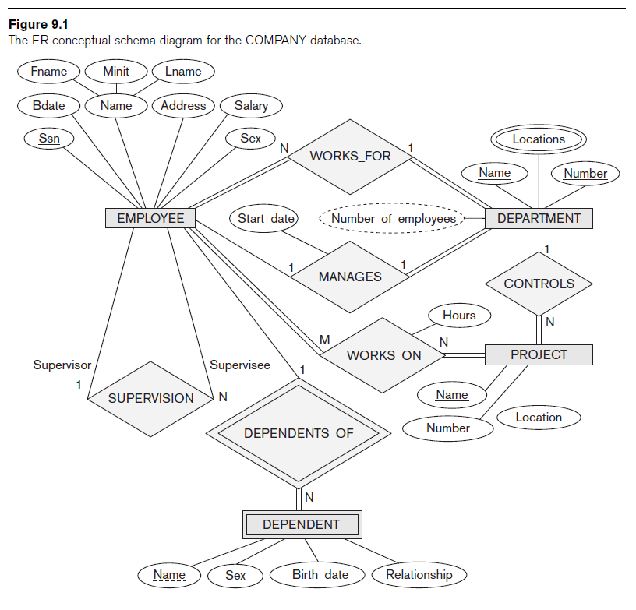
Relational Database Design Using ER-to-Relational Mapping

Slide 5
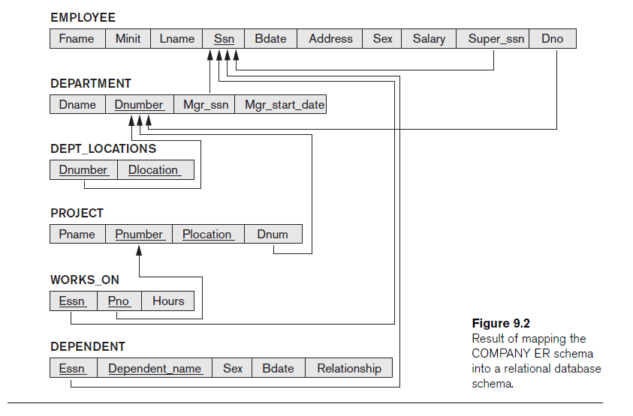

Slide 6
ER-to-Relational Mapping Algorithm
COMPANY database example
  Assume that the mapping will create tables with simple single-valued attributes
Step 1: Mapping of Regular Entity Types
  For each regular entity type, create a relation R that includes all the simple attributes of E
  Called entity relations
    Each tuple represents an entity instance

Slide 7
ER-to-Relational Mapping Algorithm (cont’d.)
Step 2: Mapping of Weak Entity Types
  For each weak entity type, create a relation R and include all simple attributes of the entity type as attributes of R
  Include primary key attribute of owner as foreign key attributes of R

Slide 8
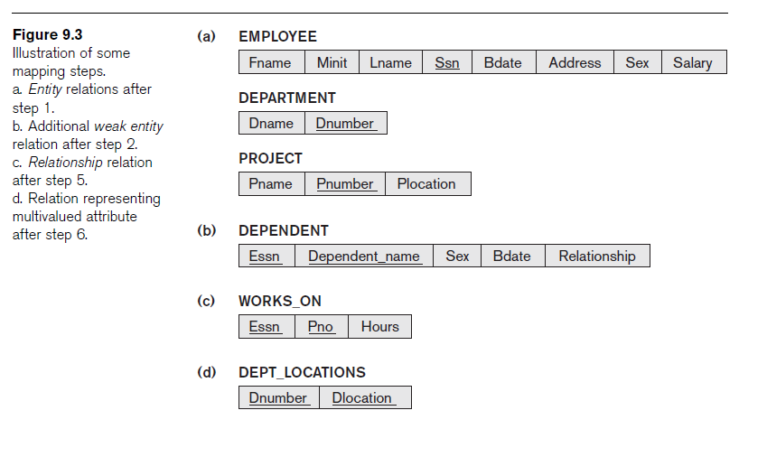
ER-to-Relational Mapping Algorithm (cont’d.)

Slide 9
ER-to-Relational Mapping Algorithm (cont’d.)
Step 3: Mapping of Binary 1:1 Relationship Types
  For each binary 1:1 relationship type
    Identify relations that correspond to entity types participating in R
  Possible approaches:
    Foreign key approach
    Merged relationship approach
    Crossreference or relationship relation approach

Slide 10
ER-to-Relational Mapping Algorithm (cont’d.)
Step 4: Mapping of Binary 1:N Relationship Types
  For each regular binary 1:N relationship type
    Identify relation that represents participating entity type at N-side of relationship type
    Include primary key of other entity type as foreign key in S
    Include simple attributes of 1:N relationship type as attributes of S

Slide 11
ER-to-Relational Mapping Algorithm (cont’d.)
  Alternative approach
    Use the relationship relation (cross-reference) option as in the third option for binary 1:1 relationships

Slide 12
ER-to-Relational Mapping Algorithm (cont’d.)
Step 5: Mapping of Binary M:N Relationship Types
  For each binary M:N relationship type
    Create a new relation S
    Include primary key of participating entity types as foreign key attributes in S
    Include any simple attributes of M:N relationship type

Slide 13
ER-to-Relational Mapping Algorithm (cont’d.)
Step 6: Mapping of Multivalued Attributes
  For each multivalued attribute
    Create a new relation
    Primary key of R is the combination of A and K
    If the multivalued attribute is composite, include its simple components

Slide 14
ER-to-Relational Mapping Algorithm (cont’d.)
Step 7: Mapping of N-ary Relationship Types
  For each n-ary relationship type R
    Create a new relation S to represent R
    Include primary keys of participating entity types as foreign keys
    Include any simple attributes as attributes

Slide 15
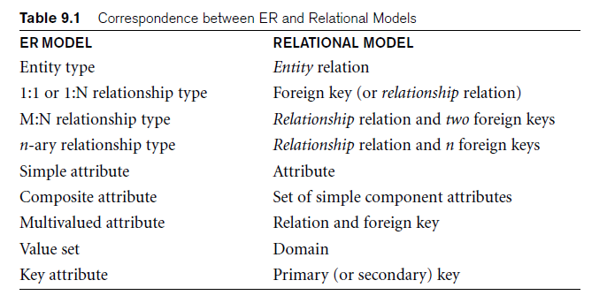
Discussion and Summary of Mapping for ER Model Constructs

Slide 16
Discussion and Summary of Mapping for ER Model Constructs (cont’d.)
In a relational schema relationship, types are not represented explicitly
  Represented by having two attributes A and B: one a primary key and the other a foreign key

Slide 17
Mapping EER Model Constructs to Relations
Extending ER-to-relational mapping algorithm

Slide 18
Mapping of Specialization or Generalization
Step 8: Options for Mapping Specialization or Generalization (see pages 294-295)
  Option 8A: Multiple relations—superclass and subclasses
    For any specialization (total or partial, disjoint or overlapping)
  Option 8B: Multiple relations—subclass relations only
    Subclasses are total
    Specialization has disjointedness constraint

Slide 19
Mapping of Specialization or Generalization (cont’d.)
  Option 8C: Single relation with one type attribute
    Type or discriminating attribute indicates subclass of tuple
    Subclasses are disjoint
      Potential for generating many NULL values if many specific attributes exist in the subclasses
  Option 8D: Single relation with multiple type attributes
    Subclasses are overlapping
    Will also work for a disjoint specialization

Slide 20
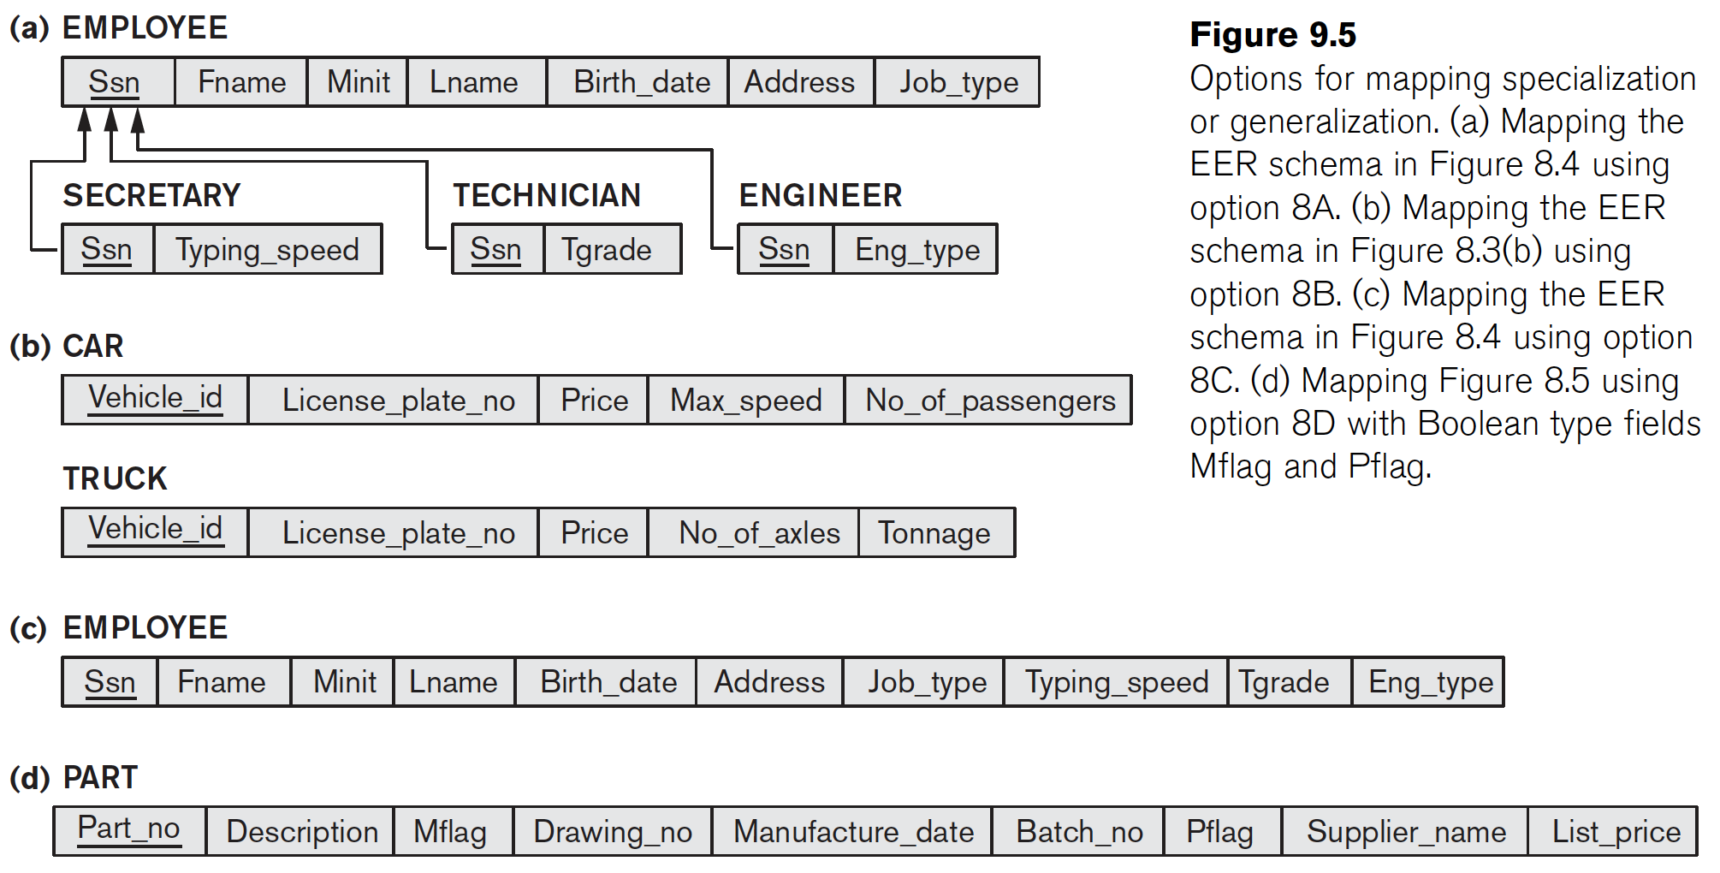
EER Mapping

Slide 21
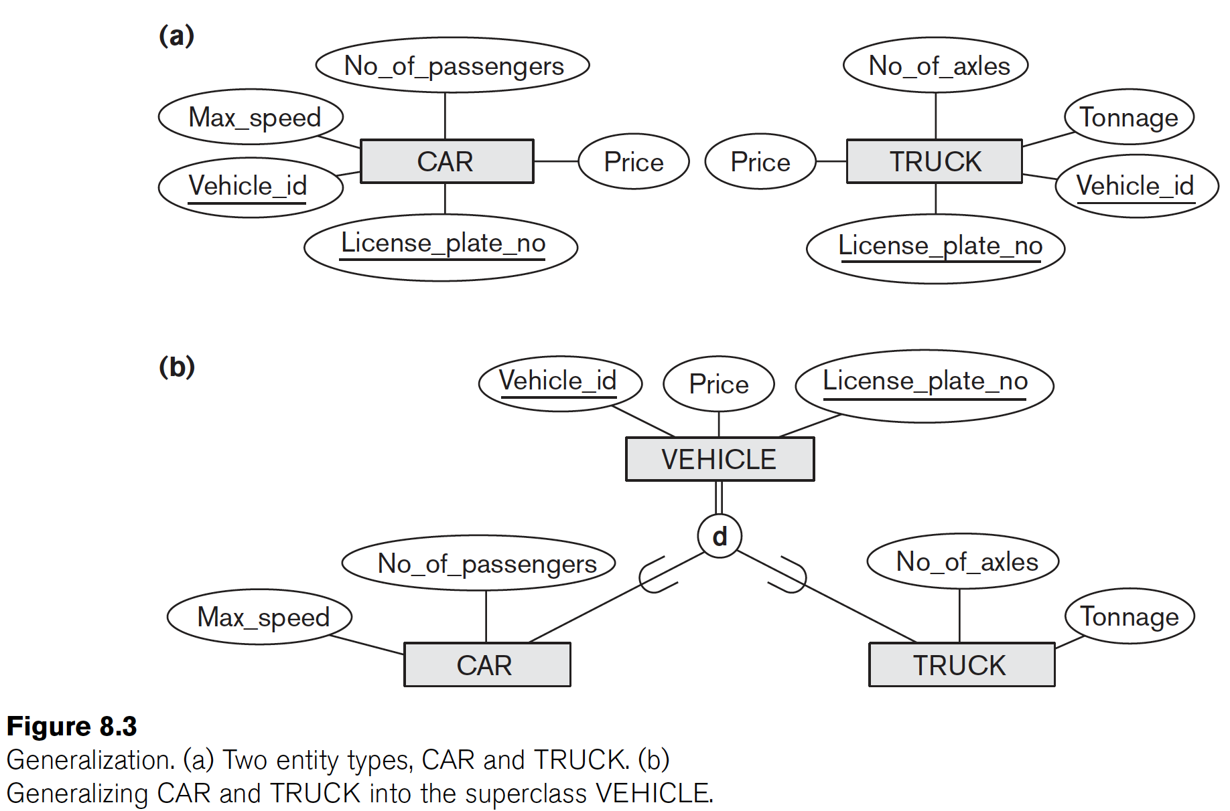

Slide 22
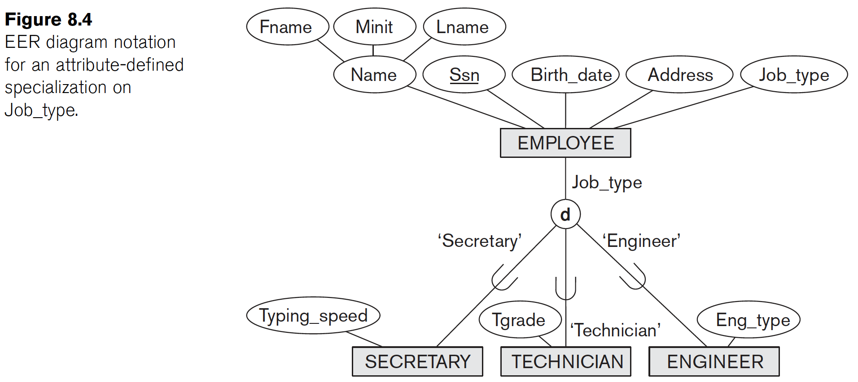
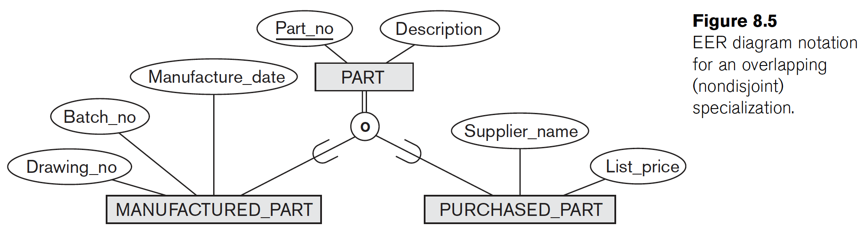

Slide 23
Summary
Map conceptual schema design in the ER model to a relational database schema
  Algorithm for ER-to-relational mapping
  Illustrated by examples from the COMPANY database
Include additional steps in the algorithm for mapping constructs from EER model into relational model

